Slide 1
Further Training with Troubleshooting
Research Infrastructure Services
Elyn Fritz-Waters

Slide 2
Outline
What is Troubleshooting?
What is Google-fu?
Topic Related Resources
Example of Troubleshooting
‘Disk quota exceeded’ example
Live Demo

Slide 3
What is Troubleshooting?
According to the dictionary
Solve serious problems for a company or other organization
Trace and correct faults in a mechanical or electronic system
According to Wikipedia
Troubleshooting is a form of problem solving, often applied to repair failed products or processes on a machine or a system. It is a logical, systematic search for the source of a problem in order to solve it, and make the product or process operational again.

Slide 4

Why is Troubleshooting Important?
Will encounter errors while working on analysis (with or without using HPC)
Better understanding of how to approach problems (even those beyond using HPC)
Useful beyond research and analysis

Slide 5
What is Google-fu?
A moniker that refers to the ability to use Google or other search methods to aid in troubleshooting or more generally, just finding information
Very helpful in troubleshooting
Most IT professionals use it daily or more often

Slide 6
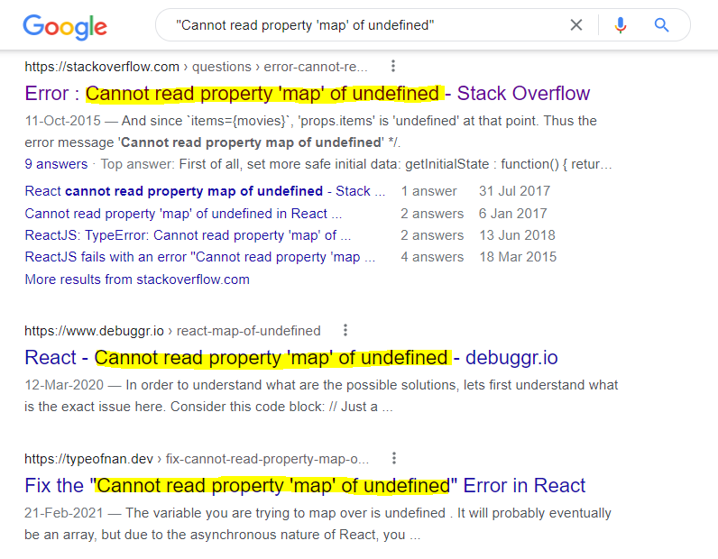
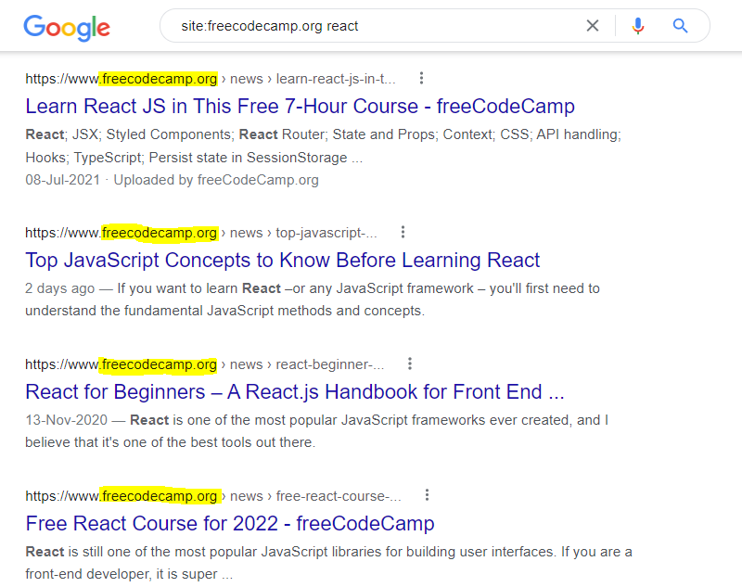
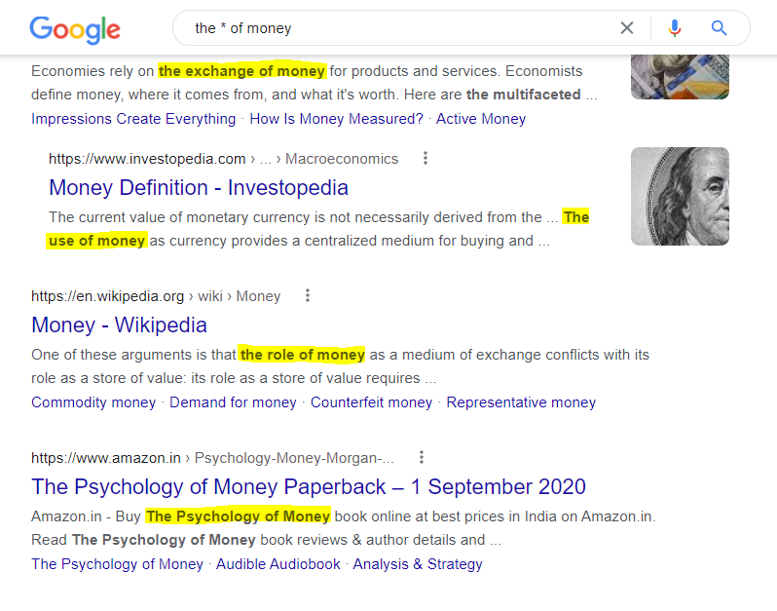
Tricks for Better Searches
Use quotes to get an “exact” match
Search a specific site with site:
Exclude a term from search results with –
Search for a particular filetype with filetype:
Use wildcard (*) to make searches
Combine searches with OR, AND logic

Slide 7
Topic Related Resources
Many fields and topics have online resources available to get questions and answers addressed.
A Google search may often bring up these resources.
Some examples include
Stack Exchange (https://stackexchange.com/)
Biostars (https://www.biostars.org/)
SeqAnswers (https://www.seqanswers.com/)

Slide 8
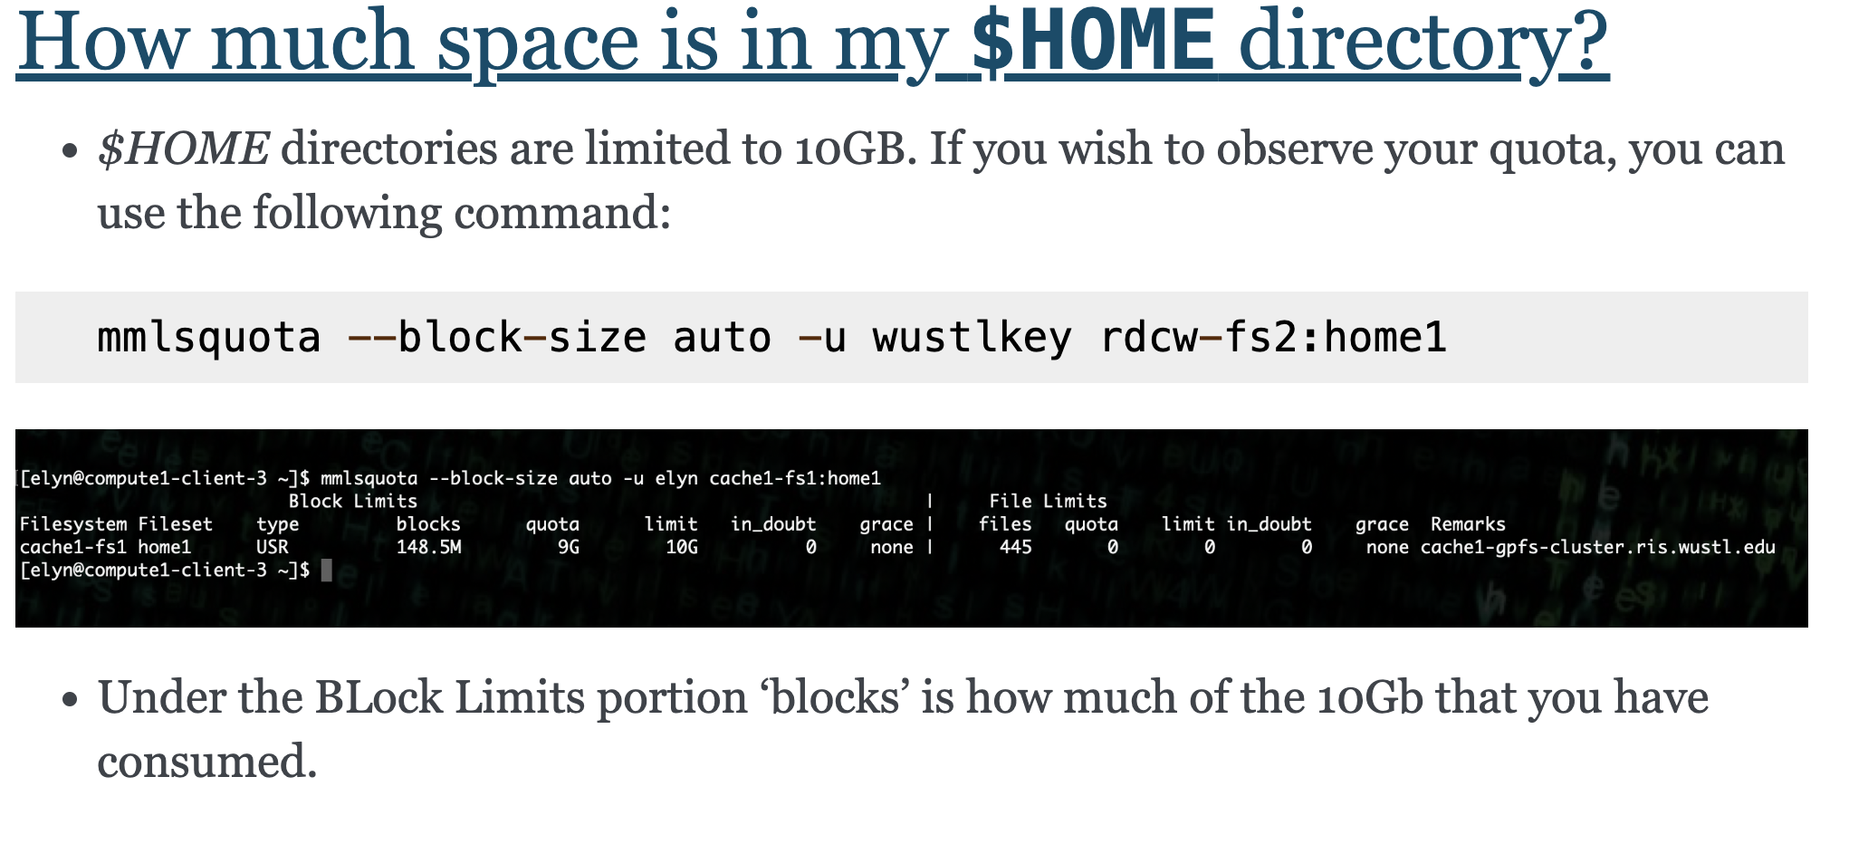
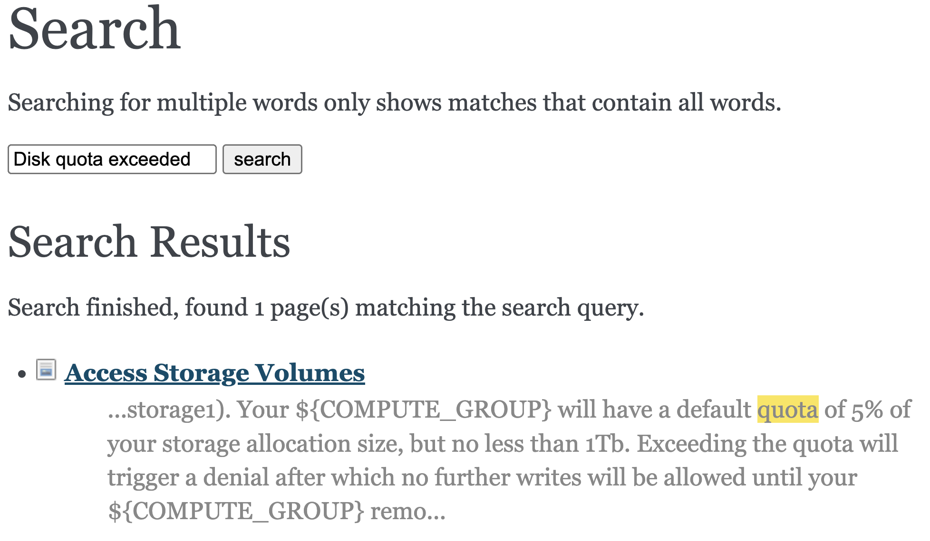
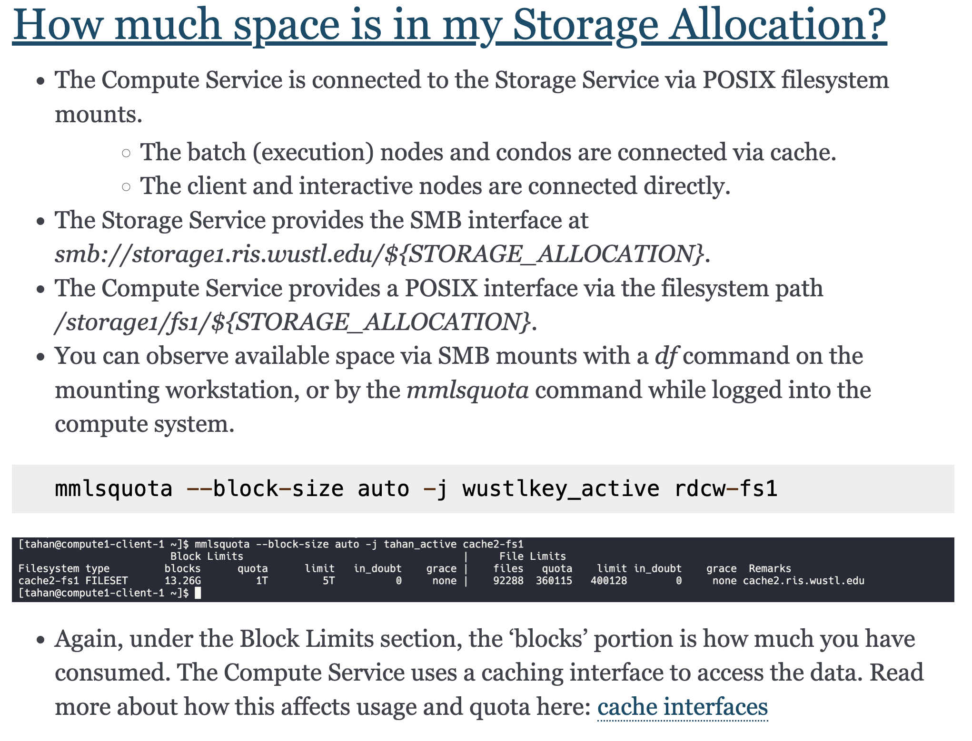
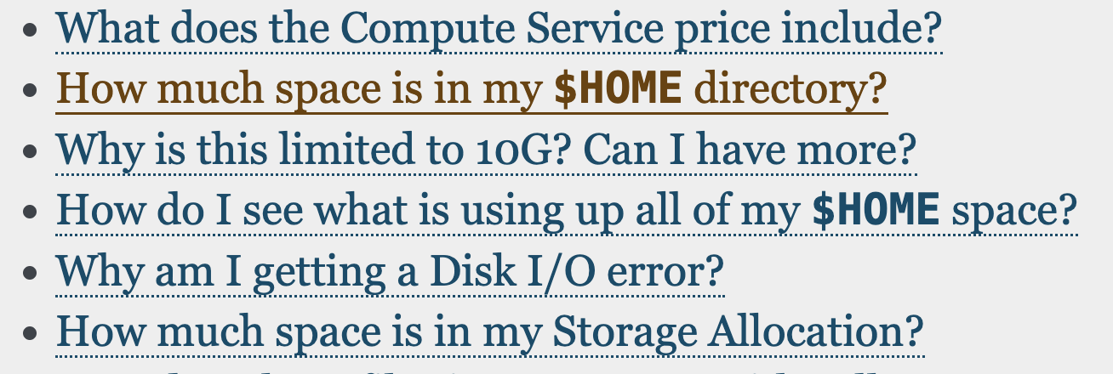
Example of Troubleshooting
Step 1: Look into RIS docs website

Slide 9
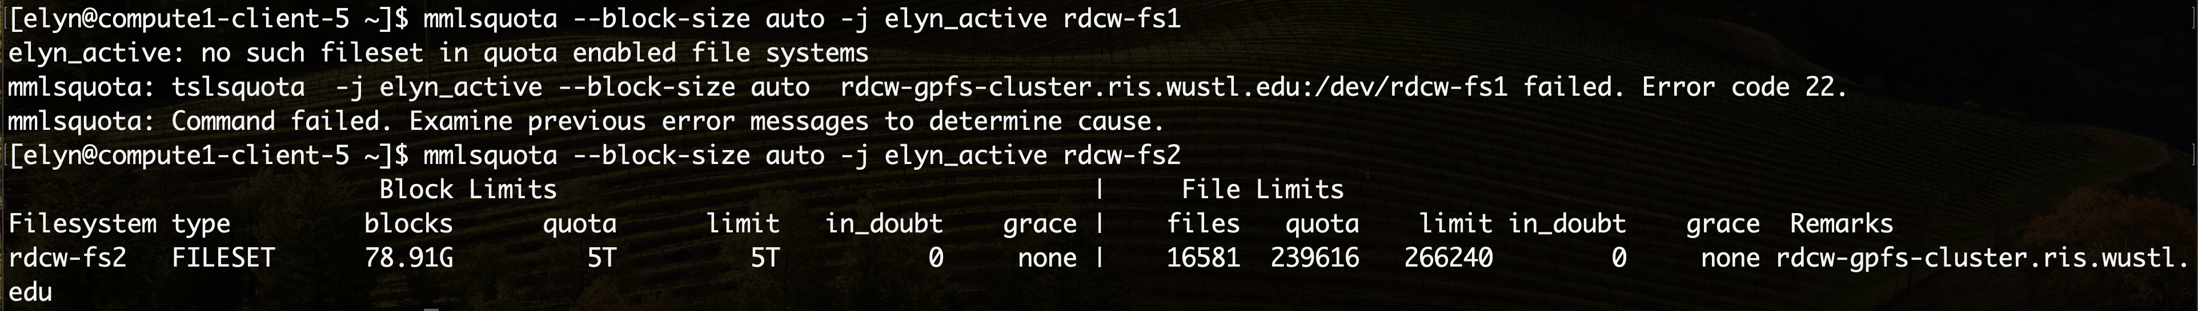
Example of Troubleshooting
Step 2: Use what we’ve found so far.

Slide 10
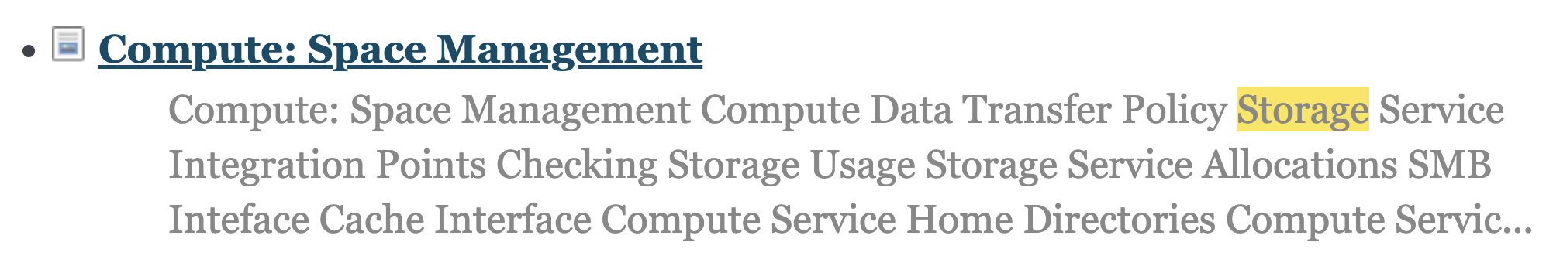
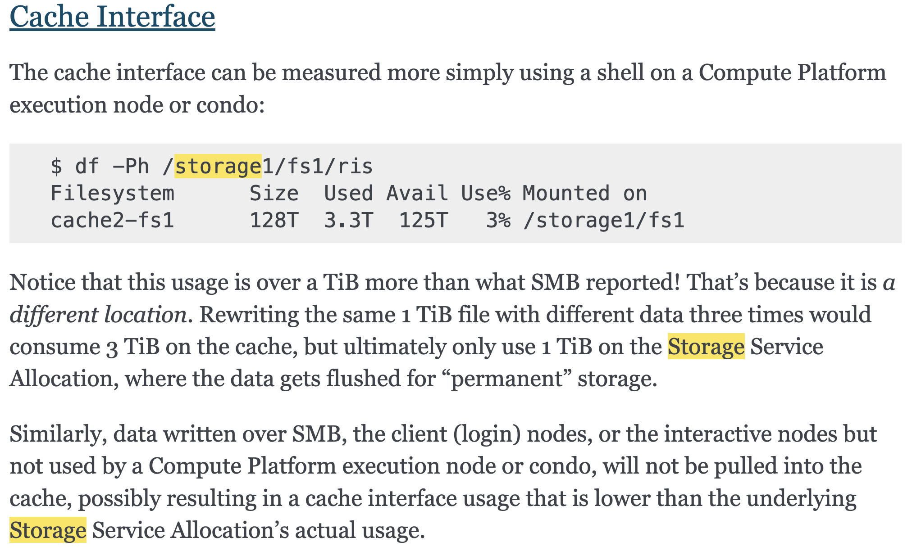
Example of Troubleshooting
Step 3: Didn’t find the issue, so we keep looking.

Slide 11
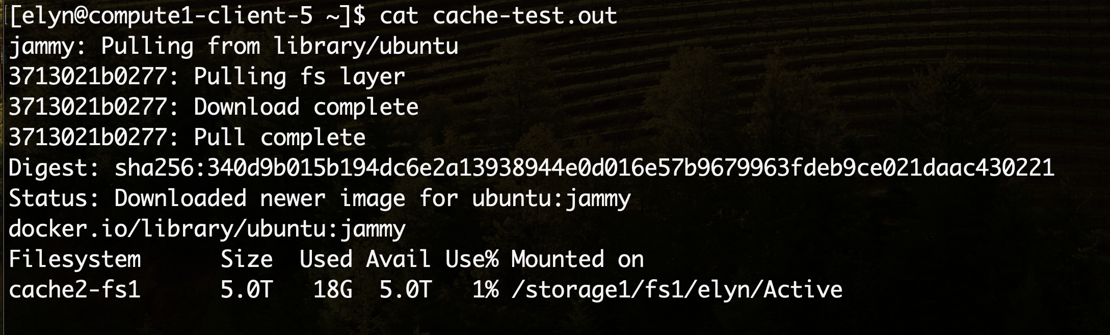
Example of Troubleshooting
Step 4: Try what we’ve found again.

Slide 12
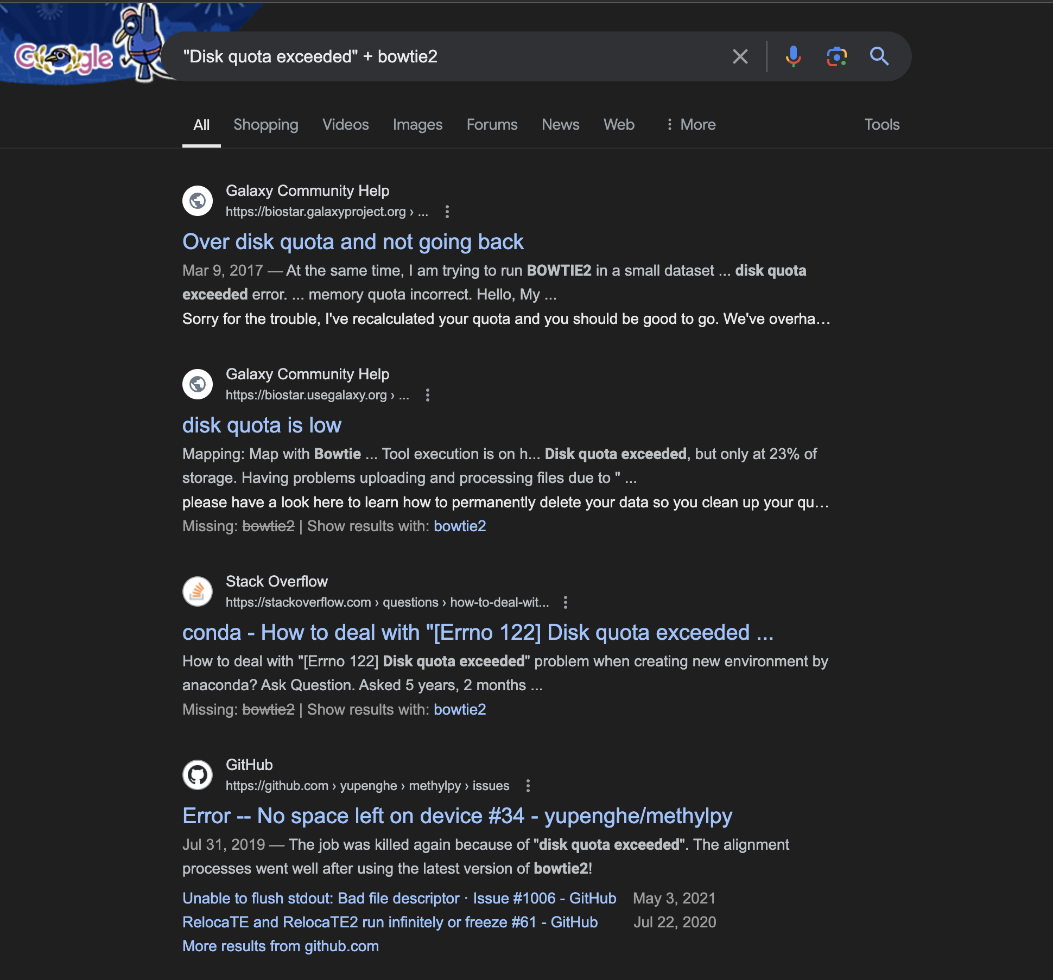
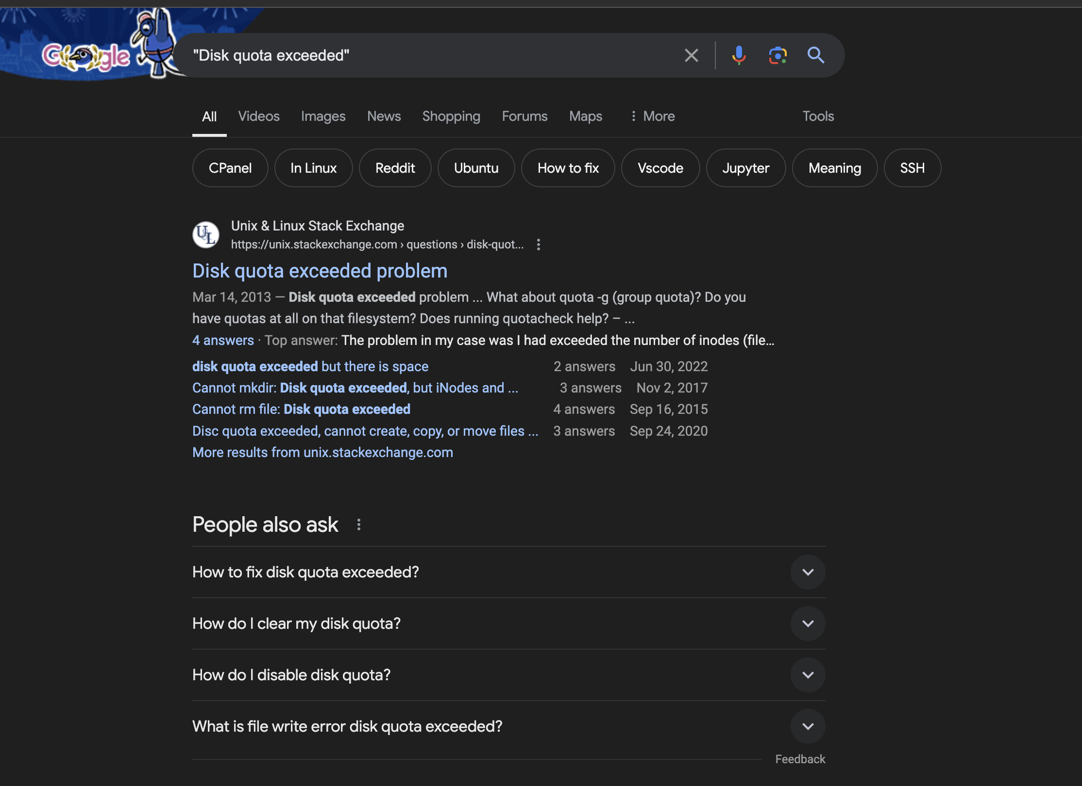
Example of Troubleshooting
Step 5: Back to the drawing board.

Slide 13
Live Demo
Creating a Docker image

